Slide 1
.NET LEARNINGS
Lotus

Slide 2
PROGRAMMING STRUCTURE
Programming Paradigm
(coding style)
Imperative
(component based)
Declarative
(data driven)
Procedural Programming
(C, Fortan, Cobol)
Object Oriented Programming
(Java)
Functional Programming
(JavaScript, Python)
Logic Programming
(Prolong)

Slide 3
Procedural vs OOPs
Structural/Procedural Language | Object Oriented Programming Language
1. Code is divided into modules or functions. | Code is made up of classes and objects.
2. Follows top-down approach. | 2. Follows bottom-up approach.
3. Poor modelling to real world. | 3. Strong modelling to real world problems.
4. Provides poor data security. | 4. Provides strong data security.
5. Not extensible programming language. | 5. Highly extensible programming language.

Slide 4
Factors leading to the development and adoption of OOPs
Complexity of software development
Code reusability
Data and code encapsulation
Real world modelling
Improved maintenance and security
Adoption to modern software challenges

Slide 5
DRAWBACKS OF OOPs
Complexity
Performance Overhead
Difficulty in debugging

Slide 6
What is OOPs?
Object oriented programming is a methodology or paradigm, to develop program using some classes and object. It simplifies software development and life cycle using some OOPs concept.

Slide 7
What is Programming Paradigm
In simple words it means coding style, or fundamental style, or approach to program a given problem statement. Different paradigm has different type of approaches and solution to the problem statement.

Slide 8
Top-down VS Bottom-up approach
TOP-DOWN APPROACH | BOTTOM-UP APPROACH
We focus on breaking up the problem into smaller parts. | We solve smaller problems and integrate it as whole and complete the solution.
It contains redundant information. | It does not contain redundant information
The implementation depends on the programming language and platform. | Data encapsulation and data hiding is implemented in this approach.
Advantages of Top-down Approach:
Clarity: Provides a clear understanding of the overall structure and goals.
Efficiency: Allows for the identification of key components early in the process.
Alignment: Aligns with high-level organizational objectives.
Advantages of Bottom-up approach:
Detail-Oriented: Captures fine-grained details and nuances.
Adaptability: Allows for flexibility and adjustments as more details emerge.
Incremental Progress: Immediate progress on smaller components can be achieved.

Slide 9
Types of Programming Paradigm
Imperative
Declarative

Slide 10
Imperative Classification
1. Structed
2. Procedural
3. Object Oriented
4. Parallel Processing
Declarative Classification
1. Functional programming
2. Logic programming
3. Aspect Oriented programming

Slide 11
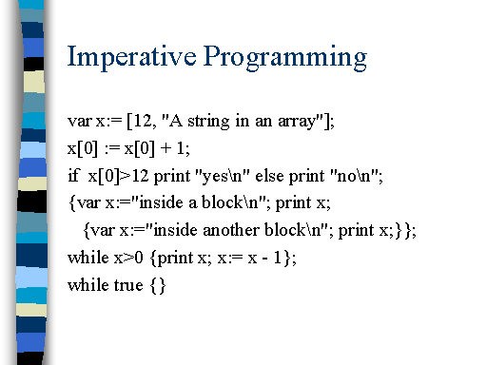
What is Imperative Paradigm?
Giving explicit instruction on how to achieve a task.
Advantages of Imperative
- Very simple to implement.
- It contains loops, variable, etc.
Disadvantages of Imperative
- Complex problem cannot be solved.
- Less efficient and less productive
- Parallel Programming in not possible

Slide 12
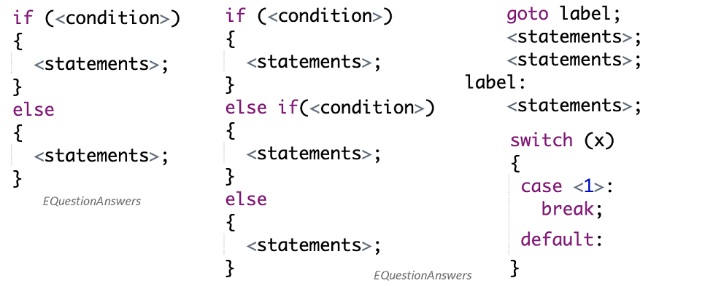
Structed Programming
It emphasizes the use of structed control flow constructs, such as loops, conditional and subroutine, to improve the clarity, quality and maintainability of software.
Based on the idea that program should be divided into small, manageable pieces that can be easily understood and modified.

Slide 13
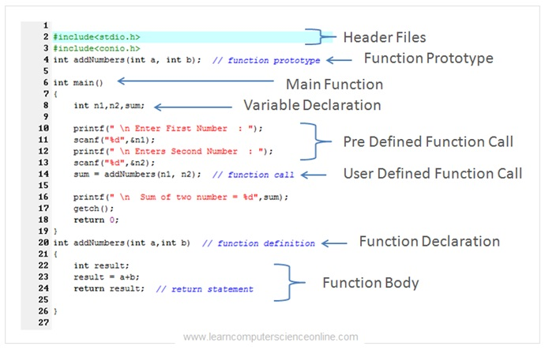
Procedural Programming
It focuses on the use of procedures, subroutines, to organize and structure code.
Ability to reuse the code.
Ex. C, C++, Java, ColdFusion

Slide 14
Difference between Structed and Procedural Programming
Structured programming is a broader concept that emphasizes the organization of code, often involving the use of modular structures and structured control flow.
Procedural programming, on the other hand, is a specific subset of structured programming where the primary focus is on procedures or routines.

Slide 15
Object Oriented Programming
Code written using classes and object.
Advantages – Data Security, Inheritance, Code Reusability, Abstraction

Slide 16
Parallel Processing Programming
Parallel processing is a technique for improving the performance of programs by executing multiple tasks simultaneously.
It involves breaking down a large task into smaller sub-tasks that can be executed in parallel, either on multiple processors or on a single processor with multiple cores.
Used in wide range of applications, including scientific simulations, data analysis, and machine learning.

Slide 17
What is Declarative paradigm?
Declarative programming is when you write your code in such a way that it describes what you want to do, and not how you want to do it. It is left up to the compiler to figure out the how.
Examples of declarative programming languages are SQL and Prolog.

Slide 18
Functional Programming
- It has its root in mathematics and is language independent.
- It is meant for some specific computation and not the data structure.

Slide 19
Logical Programming
It focuses on using logical statements to represent and manipulate data. It is based on the idea that a program should be organized around logical statements that describe the relationships between inputs and outputs.

Slide 20
Aspect Oriented Programming
Aspect-Oriented Programming (AOP) is a programming paradigm which complements Object-Oriented Programming (OOP) by separating concerns of a software application to improve modularization. The separation of concerns (SoC) aims for making a software easier to maintain by grouping features and behavior into manageable parts which all have a specific purpose and business to take care of.
Focus on logging, security and error handling, from the main logic of a program.

Slide 21
SEPERATION OF CONCERN
Separation of concerns is a principle used in programming to separate an application into units, with minimal overlapping between the functions of the individual units. The separation of concerns is achieved using modularization, encapsulation and arrangement in software layers.

Slide 22
What is class?
A class is a group of objects. It is a logical entity rather than a physical one. It takes up no memory and are also called templates for objects.

Slide 23
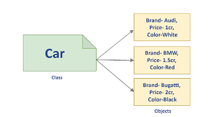
What is Object?
An object is an instance of a class, and a program may contain multiple instances of a given class. These objects have physical properties and behaviors.

Slide 24
Four Pilers of OOPs
1. Inheritance
2. Encapsulation
3. Abstraction
4. Polymorphism

Slide 25
Inheritance- When one object acquires all the properties and behavior of another object, it is called inheritance.
Encapsulation- Binding or wrapping up of code into a single unit, it is called encapsulation.
Abstraction- Hiding internal details and showing only the functionality is called as abstraction.
Polymorphism- If one task is performed in many ways, it is called as polymorphism.

Slide 26
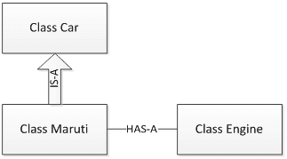
Types of Relationship in OOPs
One of the advantages of an OOP is code reuse.
2 ways we can do code reuse.
- Inheritance (IS-A relationship)
- Object composition (HAS-A relationship).
Example to understand.

Slide 27
IS-A relationship.
Based on inheritance.
Example – Apple is a fruit, Car is a Vehicle
Advantages – Code Reusability, Reduce Redundancy, Logical Hierarchy
Disadvantages – Overhead (code complexity)

Slide 28
HAS-A relationship (composition/Aggregation)
Whenever an instance of one class is used in another class
Or we can say use of instance variables that are references to other objects.
Example – Maruti has Engine, House has Bathroom.
Advantages – Flexibility, Better Encapsulation
Disadvantages – Learning curve due to deep class hierarchy, runtime overhead

Slide 29
Learning .NET

Slide 30
.NET Ecosystem
Currently, in 2021, the .NET ecosystem consists of many different components. It encompasses different runtimes, such as:
.NET Framework (WPF, Windows Forms, ASP.NET) - Windows centric.
.NET Core (ASP.NET Core, Universal Windows Platform - UWP) - Cross-platform, works side-by-side with other versions.
.NET 5 (ASP.NET Core, WPF, Windows Forms, Blazor) - A unifying platform for desktop, web, cloud, mobile, gaming, IoT, and AI applications.
Mono for Xamarin (iOS, OS X, Android) - Cross-platform.
All the above runtimes implement .NET Standard, which is a specification of .NET APIs that have implementations for each runtime. This was done so that code created for one runtime could be executed with other runtimes.
All the runtimes use tools and infrastructure to compile and run code. This includes languages (C#, Visual Basic), compilers (Roslyn), garbage collection, as well as build tools like MS Build or (Core) CLR.

Slide 31
Learning C#

Slide 32
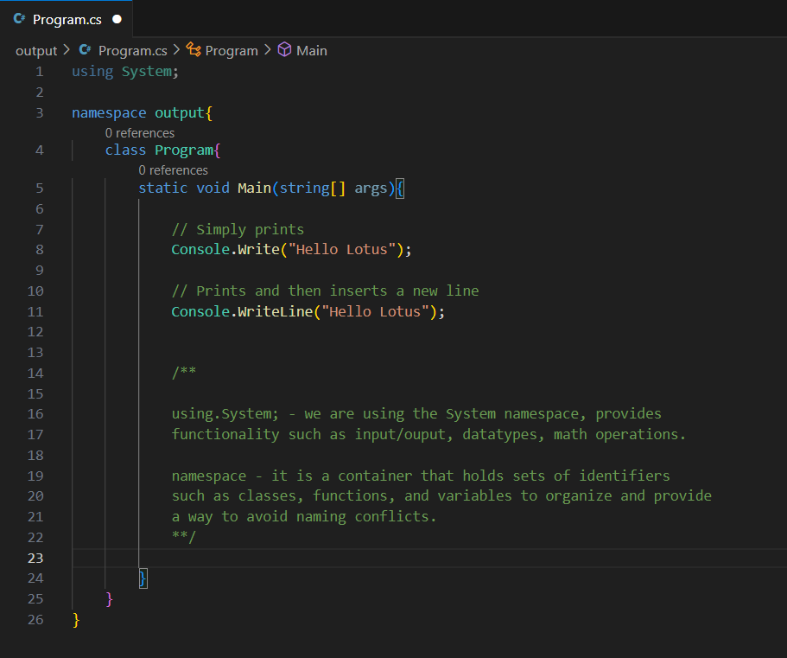
C# Output
We generally use
Console.Write(“Hello Lotus”);
Console.WriteLine(“Hello Lotus”);
Difference is,
Write() simply prints and
WriteLine() prints and then inserts a new line below.

Slide 33
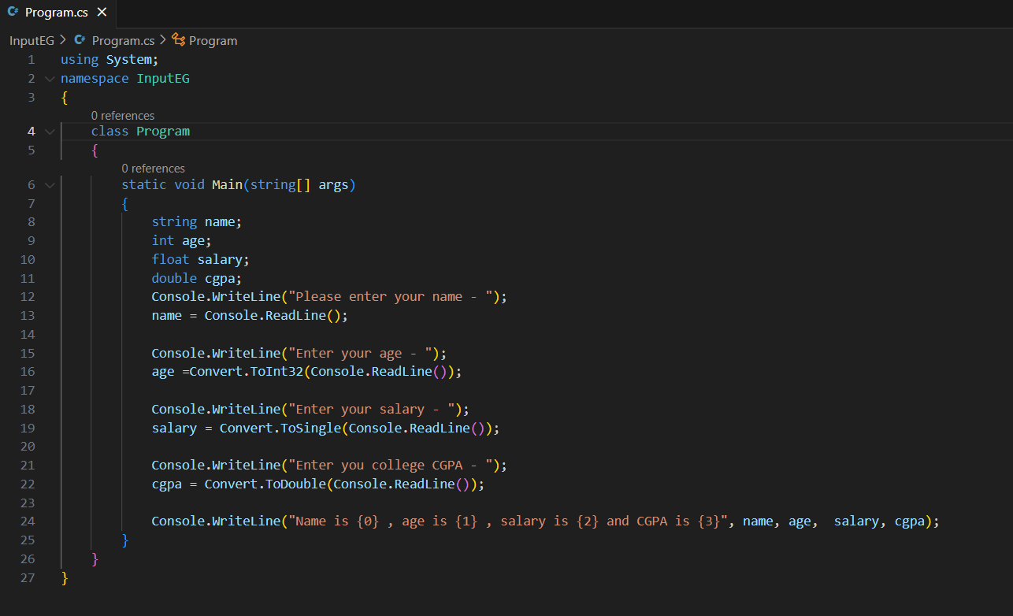
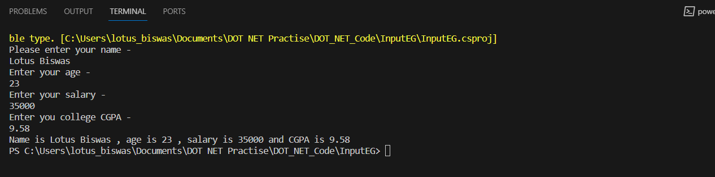
C# Input
ReadLine() – reads the next line of input from the standard input stream. It returns the same string.
Read() - reads the next line of input from the standard input stream. It returns the same string. Reads on single character.
ReadKey(): The ReadKey() method obtains the next key pressed by user. This method is usually used to hold the screen until user press a key.

Slide 34
C# Comments
Single Line comment
Multi Line comment
Single line comments
// Hii this is a comment
Multi Line comments - used for large text descriptions of code
/*
This is
a
multiline comment
*/

Slide 35
C# Variables
It is an identity given to a memory location.
They are containers to store data values.
4 Classifications
Static variables - Access static variables using class-name.
Instance variables – access using object reference.
Method Params – access directly and only inside the method
Local variables – access directly and only inside the method.

Slide 36
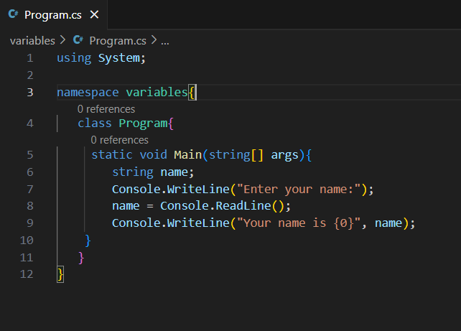
C# Variables Example
These 2 has same output:
Console.Write(“Name and age is {0} {1}”,name,age)
Console.Write(“Name and age is” + name + “ ”+ age);

Slide 37
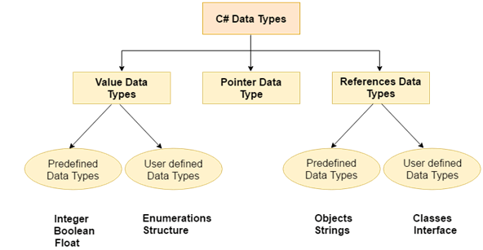
C# Datatypes types
3 Types
Value DT – they are integer based and floating point based.
Pointer DT – it is a variable, also called locator or indicator that points to an address of a value.
Reference DT – they do not contain the actual data stored in a variable, but they contain a reference to the variable.

Slide 38
C# Value Data Type
They are integer and floating point based.
2 types of Value Data Type
Predefined Data Type – such as Integer, Boolean, Float ..etc
User defined Data Type - such as Structure and Enumerations, etc

Slide 39
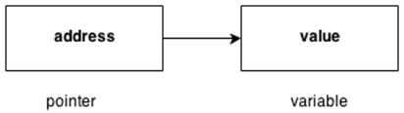
C# Pointer Data Type
It is a variable, also known as locator or indicator, which points to an address of a value.
& (Ampersand Sign) | * (Asterisk Sign)
Address Operator | Indirection Operator
Determines the address of a variable | Access the value of an address

Slide 40
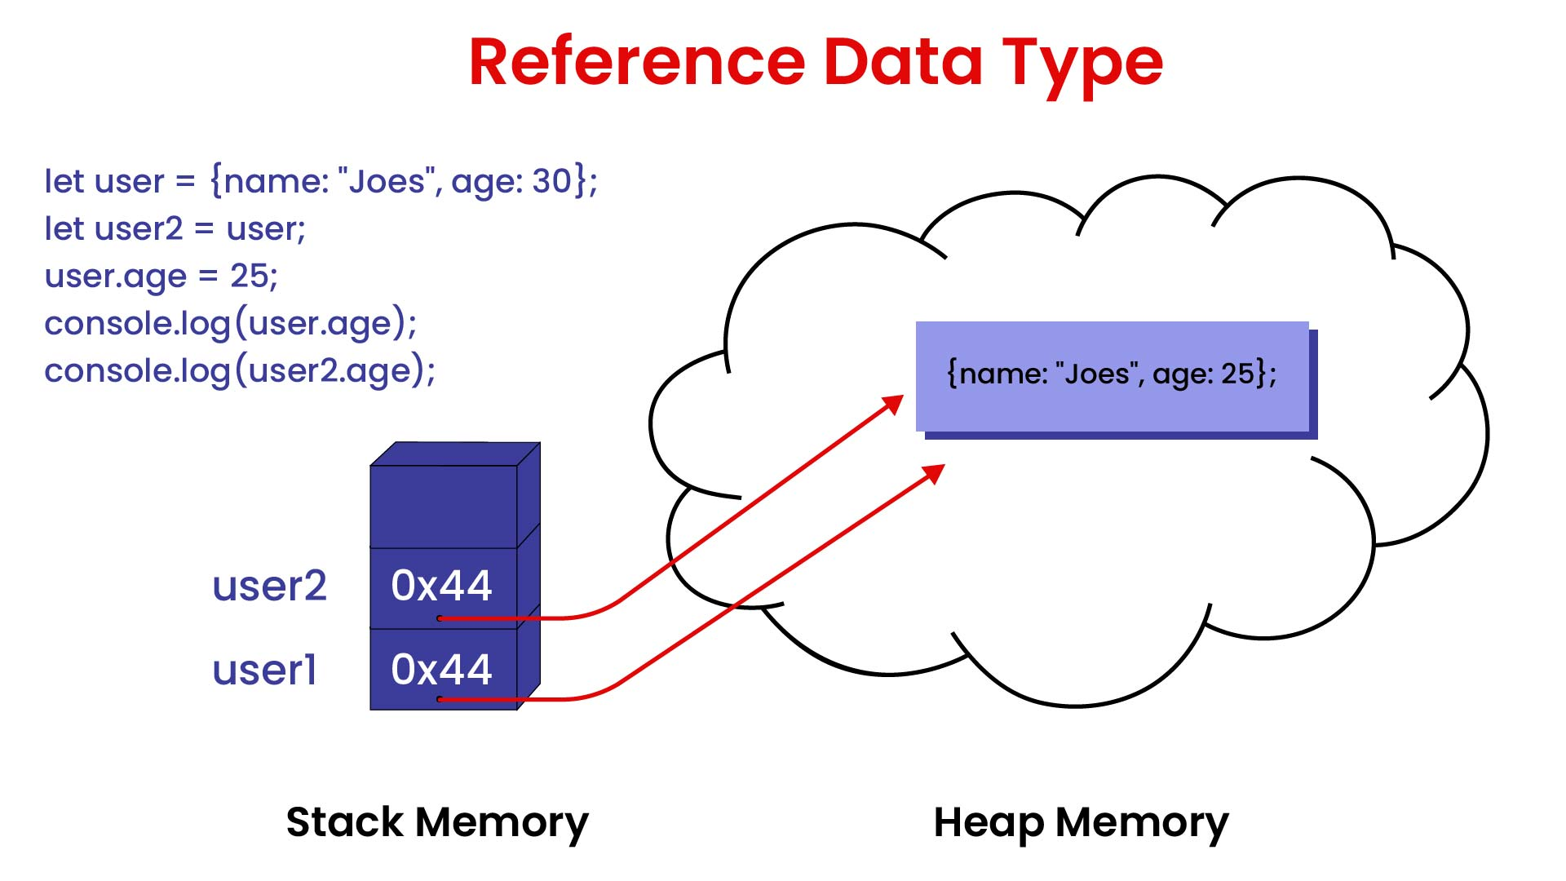
C# Reference Data Types
They do not contain the actual data stored in a variable, but they contain a reference to the variable. If the data is changed by one of the variables, the other variable automatically reflects this changes in value.
2 types of reference data types
Predefined types – Objects, string
User defined types – classes, Interface

Slide 41
C# Datatypes
Datatypes specify the type of data that a variable can store such as int, float, double.
Integer – int lotus; → 4 bytes
Long – long lotus; → 8 bytes (used for storing long integers)
Floating point number – float lotus; → 4 bytes
Double – double lotus; → 8 bytes
Character – char a = ‘A’; → 2 bytes
Boolean – bool isGreat = true; → 1 bit
String – string name = “Lotus”; → 2 bytes per character
KB
1 byte – 8 bit

Slide 42
Data types
Type | Size | Value Range
Sbyte | 8 bits | -128 to 127
Byte | 8 bits | 0 to 255
char | 16 bits
Short | 16 bits | -32,768 to 32,767
Ushort | 16 bits | 0 to 65,535
Int | 32 bits | -2,147,483,648 to 2,147,483,647
Unit | 32 bits | 0 to 4,294,967,295
Long | 64 bits | -9,223,372,036,854,775,808 to 9,223,372,036,854,775,807
Ulong | 64 bits | 0 to 18,446,744,073,709,551,615

Slide 43
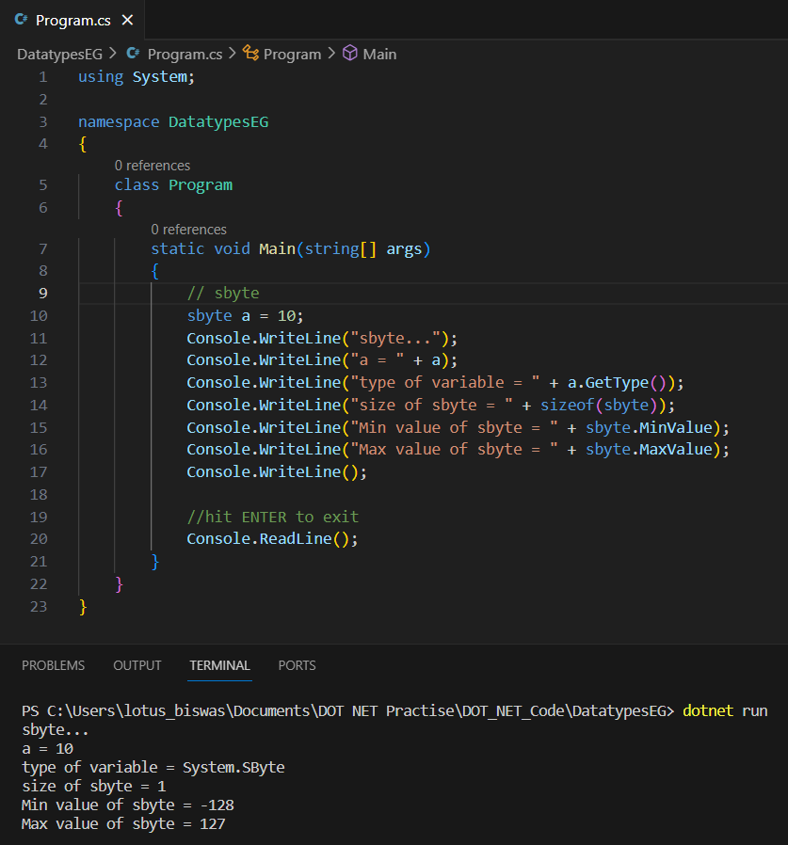
C# Datatype : sbyte

Slide 44
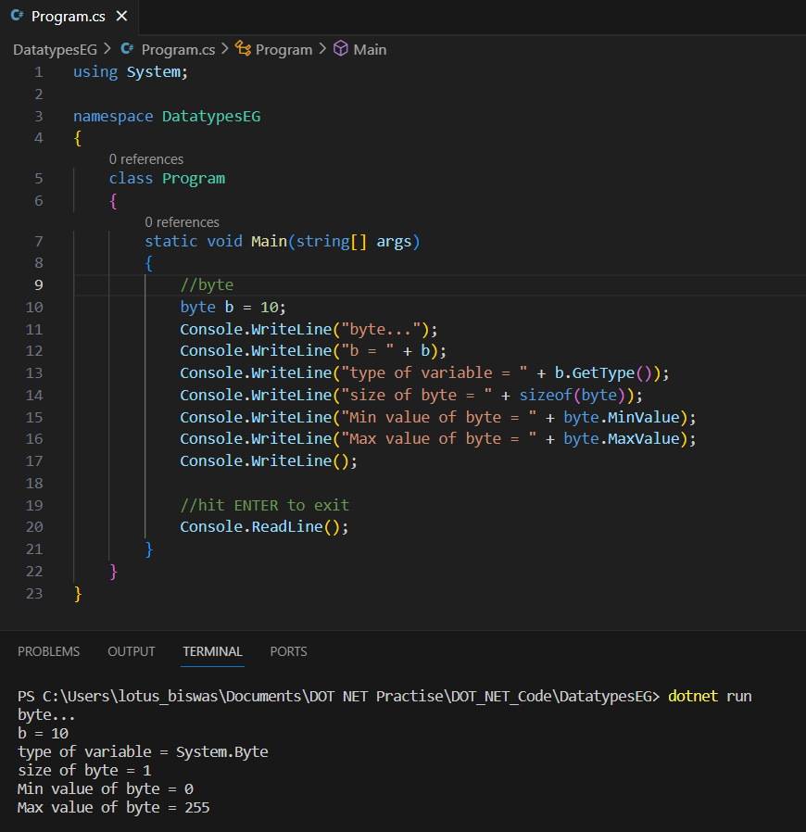
C# Datatype byte

Slide 45
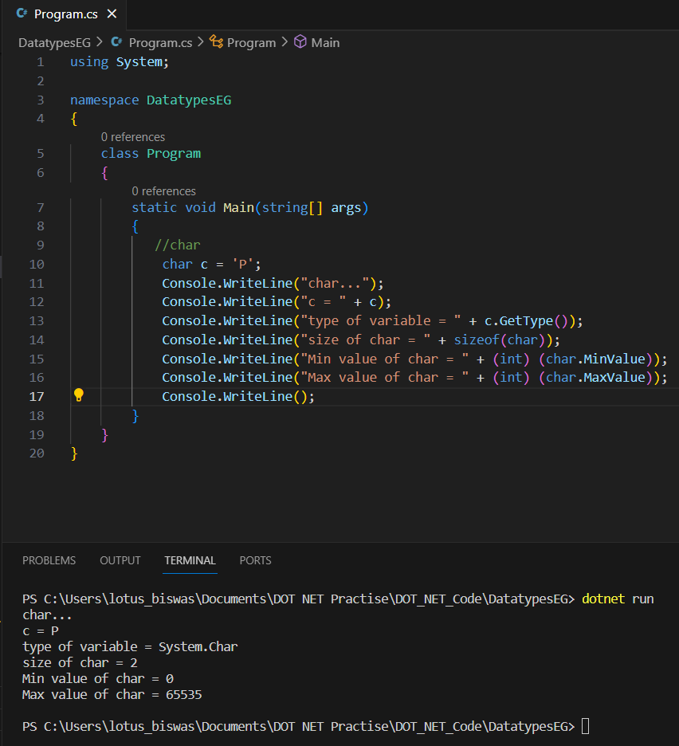
C# Datatype char

Slide 46
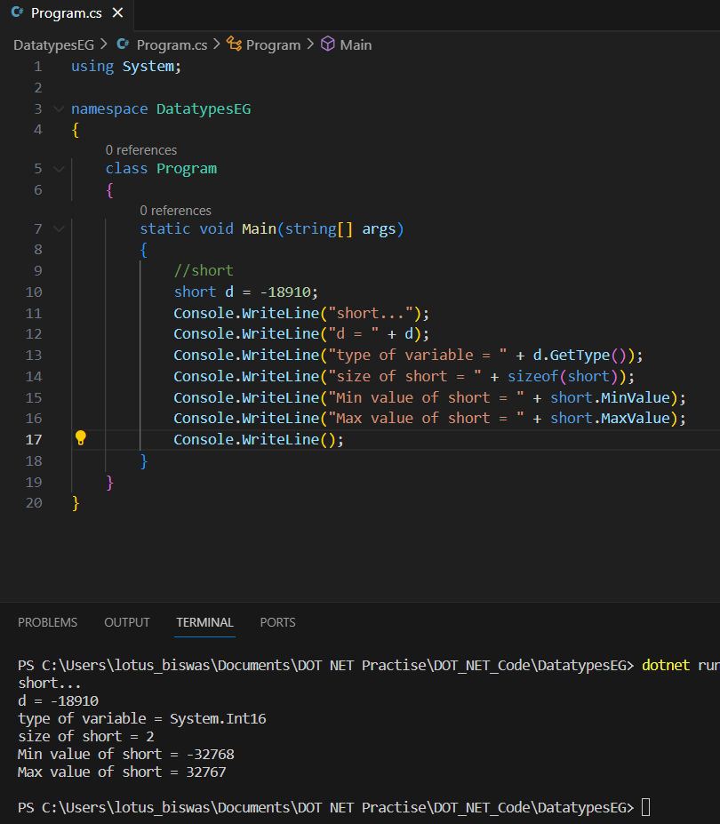
C# datatype short

Slide 47
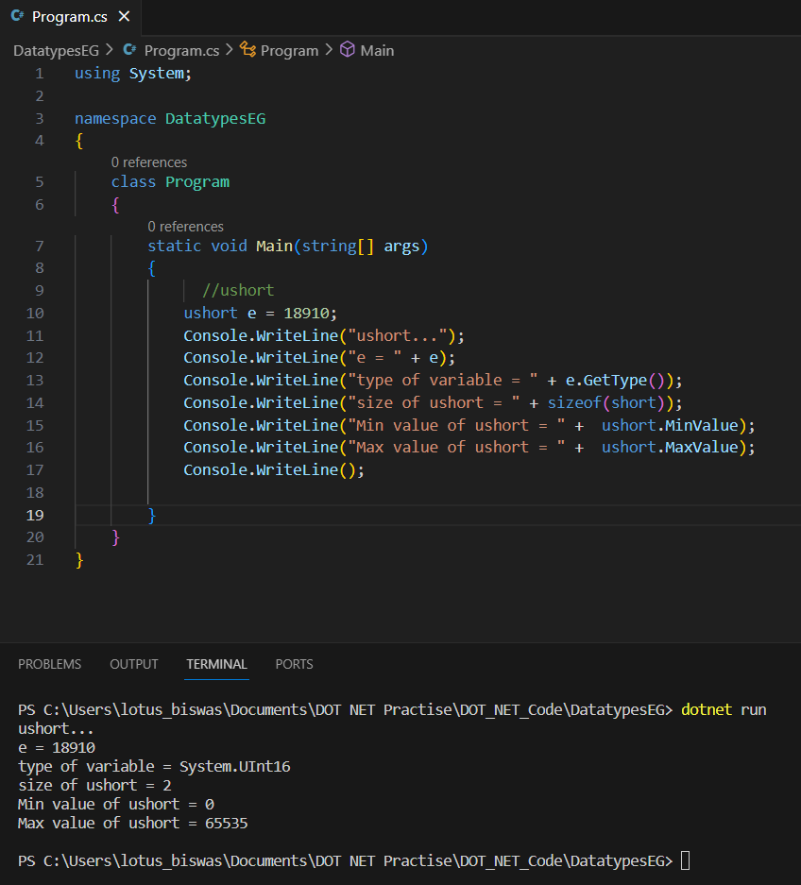
C# Datatype ushort

Slide 48
Diff between int, long, double, float
int | long | double | float
Represents 32-bit signed integers | Represents 64-bit signed integers. | Represents 64-bit double-precision floating-point numbers. | Represents 32-bit single-precision floating-point numbers.
System.Int32 | System.Int64 | System.Double | System.Single
Commonly used for general-purpose integer arithmetic. | Used when a larger range of integer values is required. | Useful for representing real numbers, including fractional parts. | Useful when memory efficiency is crucial, and precision loss is acceptable.
int myInt = 42; | long myLong = 1234567890123456789L; | double myDouble = 3.14; | float myFloat = 3.14f;
Precedence of datatypes= Long > double >int > float

Slide 49
Object/var/dynamic
Then, let’s check the difference among these three types:
Declaration and Initialization
Object: Assigning is not required;
Var: Assigning is mandatory at the time of declaration;
Dynamic: Assigning is not required.
2. Value acceptance / storage
Object: Possible to store any kind of data type;
Var: You can store any type of value, but initialization is mandatory;
Dynamic: Possible to store any kind of data type.
3.Passing as a method argument
Object: Yes, we can pass it as a method argument;
Var: No;
Dynamic: Like an object, we can pass it as a method argument.

Slide 50
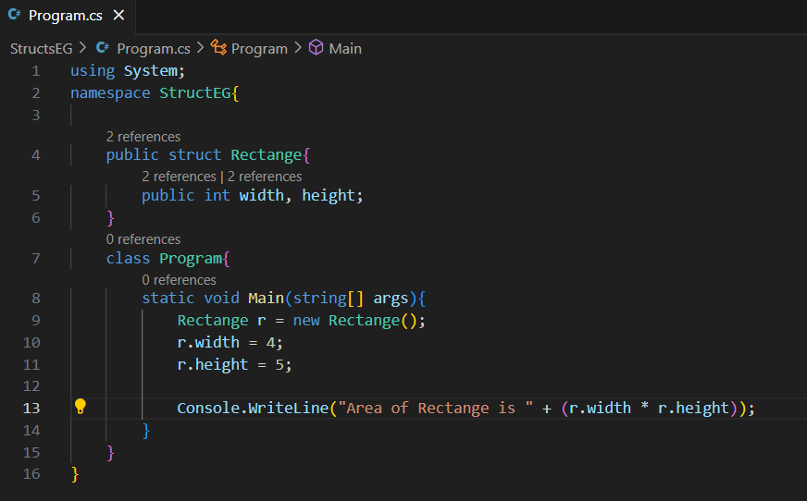
C# Structure
A struct is similar to a class, with a key diff.
A struct is a value type, whereas a class is a reference type.
A struct does not support inheritance(other than implicitly deriving from object.
A struct can have all the members a class can, except the following:
• A parameter less constructor
• Field initializers
• A finalizer
• Virtual or protected members
Because a struct is a value type, each instance does not require instantiation of an object
on the heap; this incurs a useful savings when creating many instances of a type. For
instance, creating an array of value type requires only a single heap allocation
It is useful if you have data that is not intended to be modified after creation of struct.

Slide 51
Differences between C# classes and C# Structures
Classes are references types of data type; structures are value type of data type.
Classes support default constructor i.e., we can set default values that will be assigned while creating an object. Structures do not support the concept of the default constructor; we cannot set values like classes that can be used as default values while creating a structure object/variable.
Classes support the inheritance; structures do not support the inheritance.
Structs are best used when you need to represent simple data types, such as integers, strings, or other basic data types. They are also useful when you need to work with large datasets, such as arrays or lists, where performance is critical.
You should also use a struct when you need to pass a small amount of data to a method, and you want to avoid the overhead of passing a reference to a class.
Classes are best used when you need to represent more complex objects, such as real-world entities like cars, people, or animals. They are also useful when you need to create hierarchies of objects, where one class inherits from another.
You should also use a class when you need to work with large amounts of data, such as when you’re working with a database or other external data source.

Slide 52
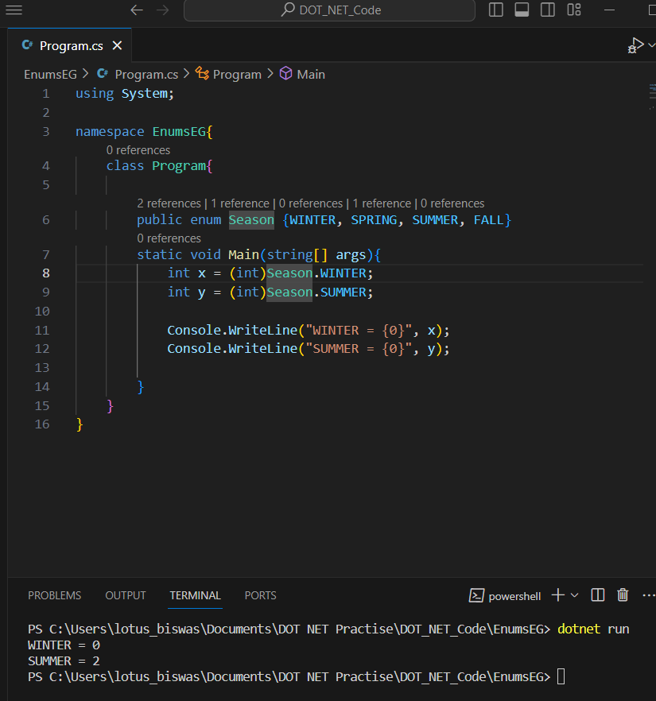
C# Enums
It is used to store a set of named constants such as season, days, month, size etc.
Why use Enums?
Code is easier to maintain, because only expected values of variables are determined
Code is easier to read, because easily identifiable names are assigned

Slide 53
C# Access Modifiers
It is used to specify the accessibility or scope of a variable functions.
C# supports 5 types of access specifiers:
Public
Protected
Internal
Protected Internal
Private

Slide 54
Access Specifiers
Public | It specifies that access is not restricted.
Protected | It specifies that access is limited to the containing
Internal | It specifies that access is limited to the current assembly.
Protected Internal | It specifies that access is limited to the current assembly or types derived from the containing class
Private | It specifies that access is limited to the containing type.

Slide 55
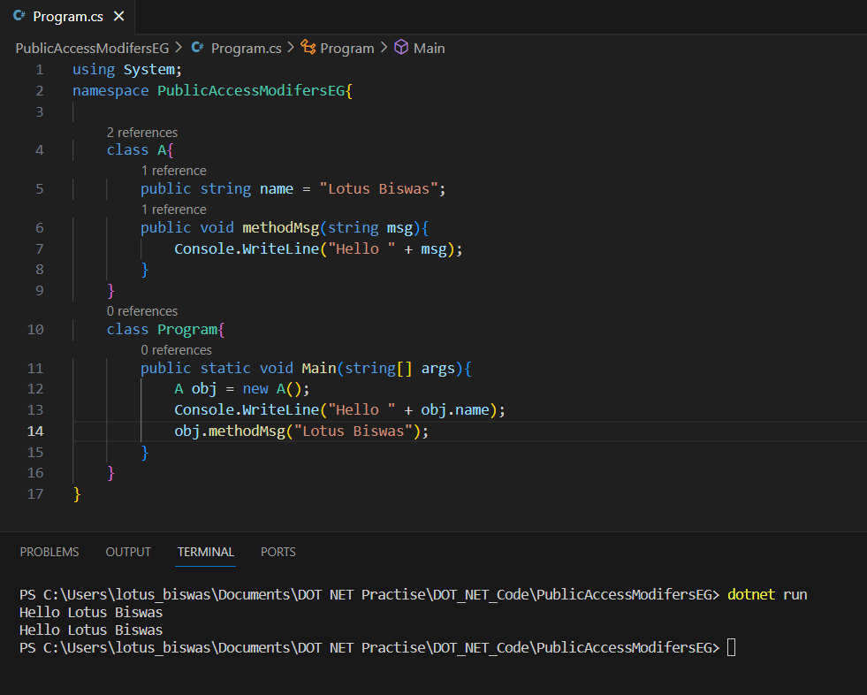
C# Public access specifiers
It makes data accessible publicly. It does not restrict data to the declared block.

Slide 56
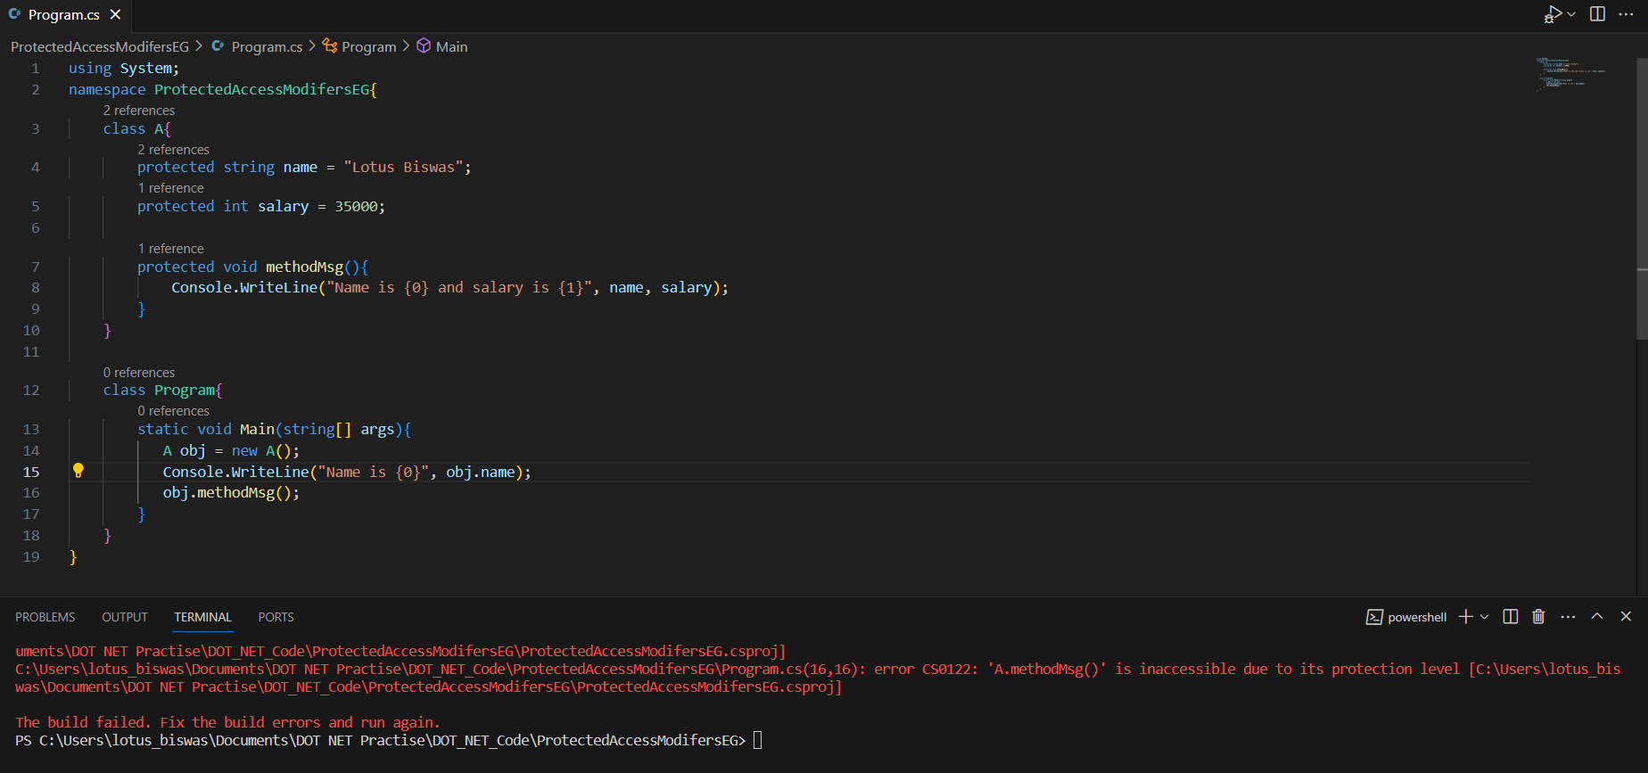
C# protected access specifiers
It is accessible within the class and has limited scope. It is also accessible within sub class or child class, in case of inheritance.

Slide 57
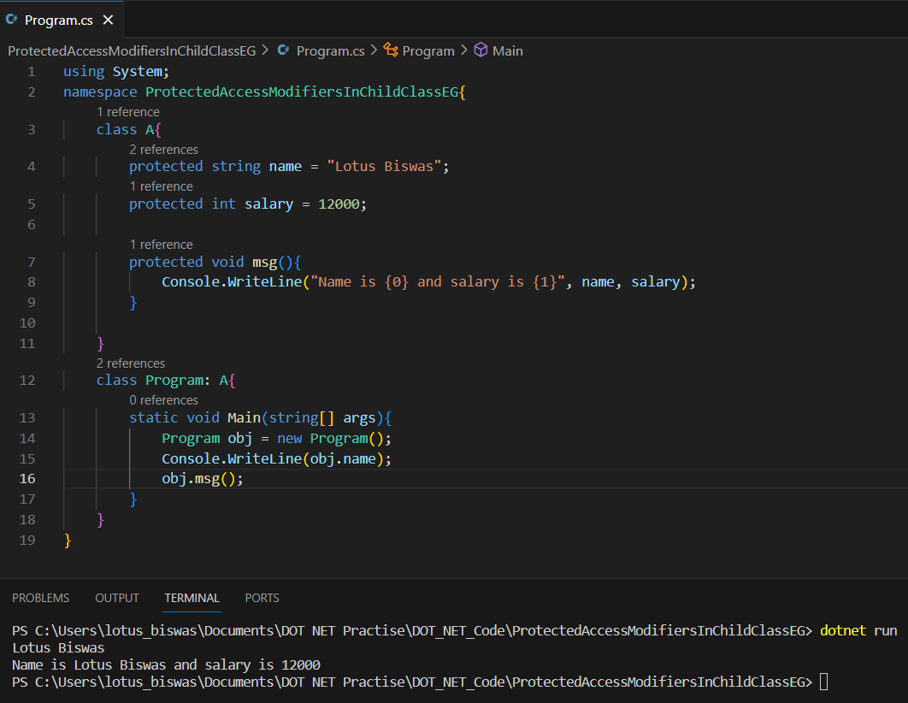
C# accessing protected access member in the child class
As protected access modifiers can be accessed in the derived class, here is the example.

Slide 58
C# Internal access specifiers

Slide 59
C# Arrays
An array is a group of similar types of elements that have contiguous memory locations.
In C# array is an object of base type System.Array.
Advantages:
- Code Optimization
- Random access
- Easy to manipulate data
- Easy to sort and traverse data.
Disadvantages:
- Fixed Size

Slide 60
C# Array Types
Single Dimensional Array
Multi-Dimensional Array
Jagged Array

Slide 61
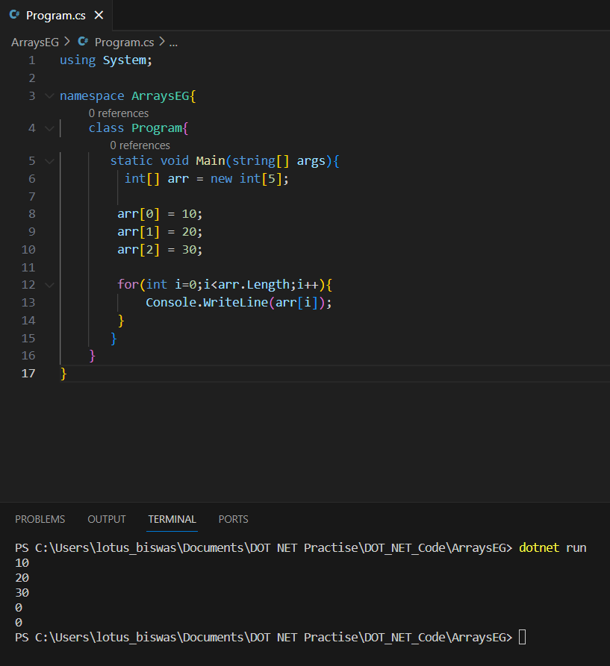
Single Dimensional Array
int[] arr = new int[5];
// we cannot add [] after the identifier
int arr[] = new int[5]; //compiler time error
// Declaring and init with size
Int[] arr = new int[5]{10,20,30,40,50};
//Declaring omiitng the size
Int[] arr = new int[]{10,12,13,14,15};
// omitting the new operator
Int[] arr = {10,20,30,40,50};

Slide 62
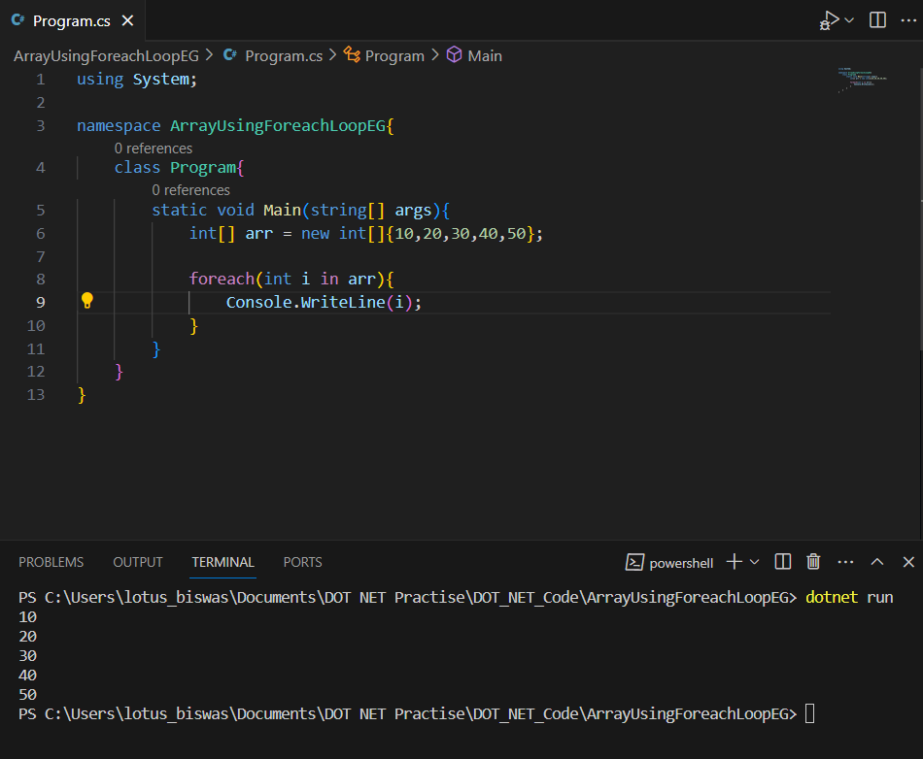
C# Foreach loop
We can also traverse the array elements using foreach loop. It returns array element one by one.
Syntax is:
Foreach(int i in arr){
}

Slide 63
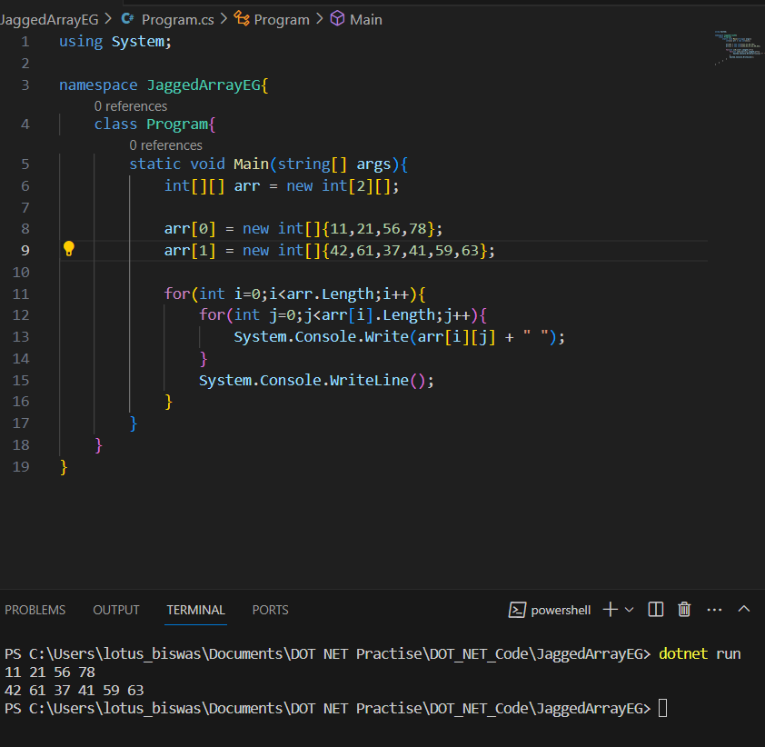
C# Jagged Array
In C#, jagged array is also known as "array of arrays" because its elements are arrays. The element size of jagged array can be different.

Slide 64
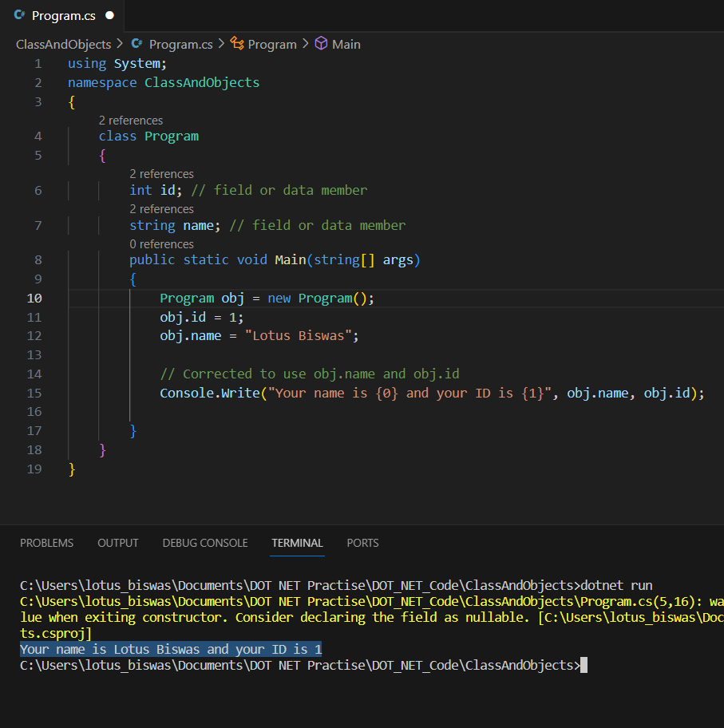
C# Objects and Classes
Class - A class is a group of objects. It’s a logical entity rather than a physical one, class takes up no memory and are also called templates for objects.
Objects – An object is an instance of a class, and a class may have multiple instances of a given class. These objects have physical properties and behaviour.

Slide 65
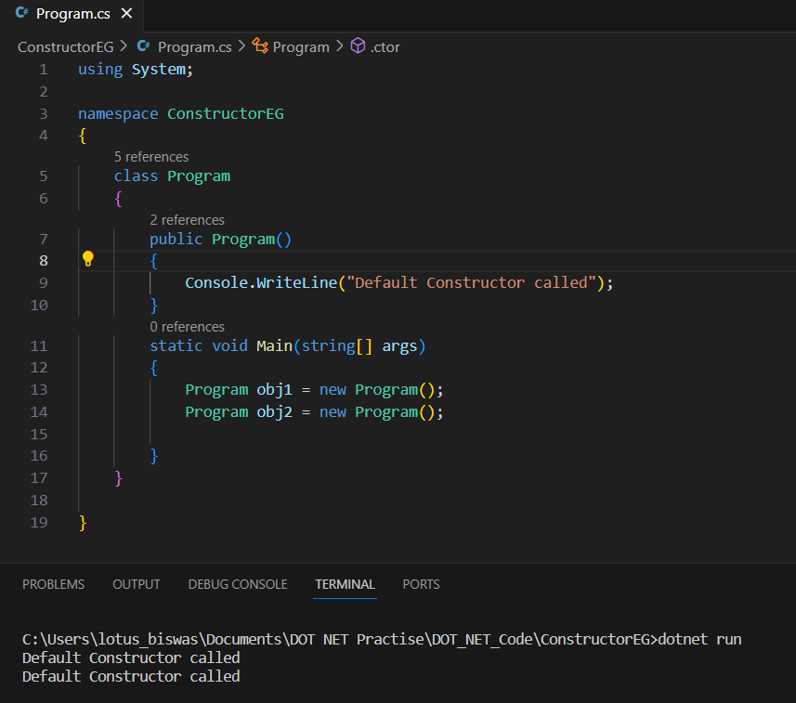
C# Constructor
Constructor can be defined as a special member function of a class that is responsible for initializing a newly created object of the class.
They are called automatically when we create an instance of a class.
2 Types of constructor
Default – When there is no constructor defined, the compiler automatically creates a no argument constructor at runtime.
Parameterized - Constructor having any parameters are known as parametrized cons and not having params called as non-parameterized constructor.
Static constructor - It is used to initialize the static members of a class. It is called automatically before any static members are accessed or any static methods are called, and it is executed only once per type, typically when the type is first accessed or instantiated.
static Program(){
}

Slide 66
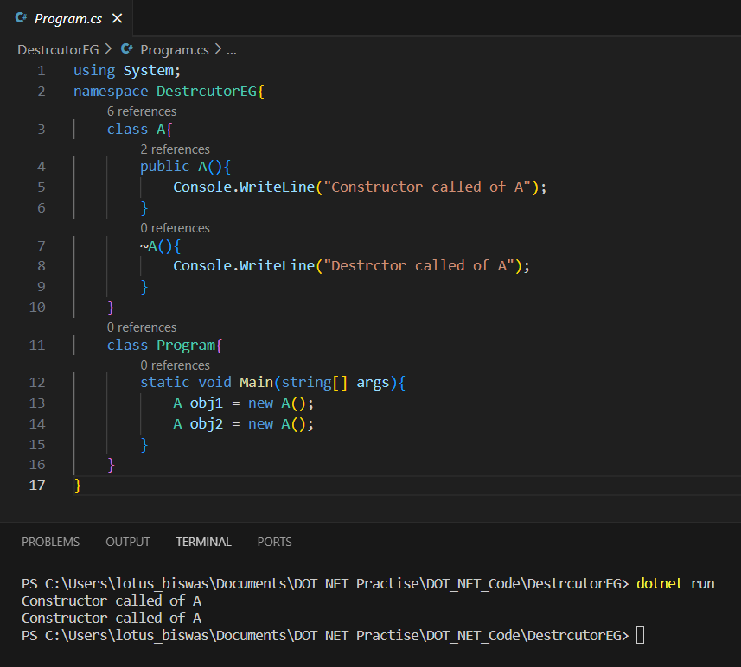
C# Destructor
A destructor works opposite to constructor, It destructs the objects of classes. It can be defined only once in a class. Like constructors, it is invoked automatically.
C# destructor cannot have parameters. Moreover, modifiers can't be applied on destructors.
Destructor can't be public. We can't apply any modifier on destructors.

Slide 67
Constructor VS Destructor
Constructor | Destructor
Invoked when an object is created. | Invoked when an object is about to be destroyed.
Mainly used for initializing object attributes, allocating resources, and performing setup task. | Used for releasing resources, performing cleanup task, and finalizing operations before an object is destroyed.
Constructor mainly used for:
- Initialization
- Resource allocation
Destructor mainly used for:
- Resource deallocation
- Cleanup
- Finalization

Slide 68
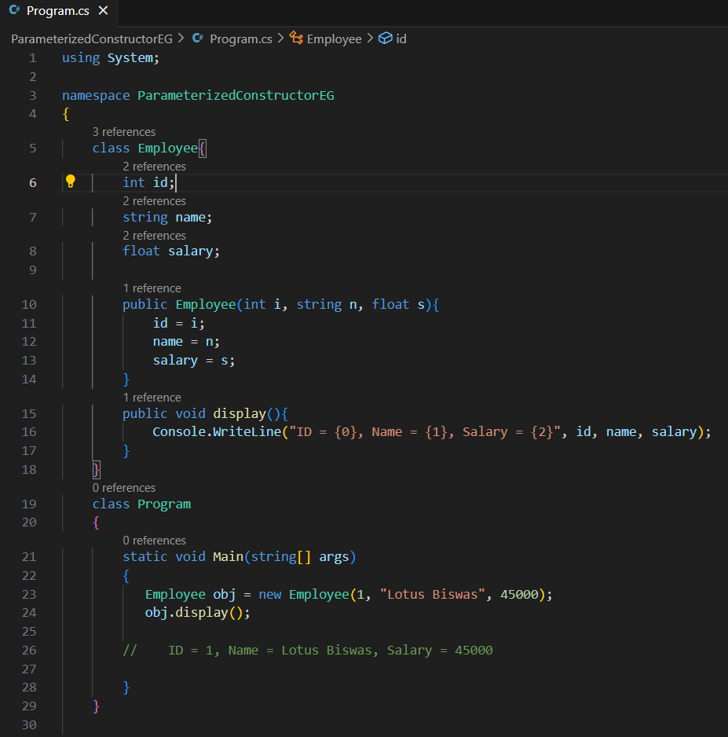
Parameterized VS Non-Parameterized Constructor

Slide 69
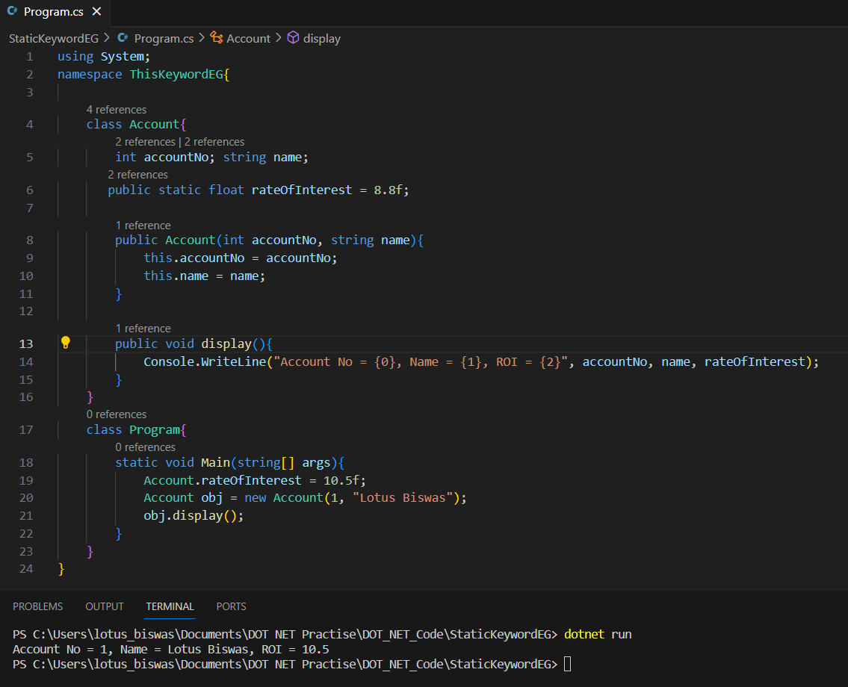
C# static keyword
Static keyword is used for memory management mainly. We can apply static keyword with variables, methods, blocks and nested class.
It belongs to the class than an instance of the class
It gets memory only once at the time of class loading.
Used to refer to the common properties of all object.
Advantage
There is only one copy of static field created in the memory. It is shared to all the objects. We need not create instance for accessing the static members, so it saves memory.

Slide 70
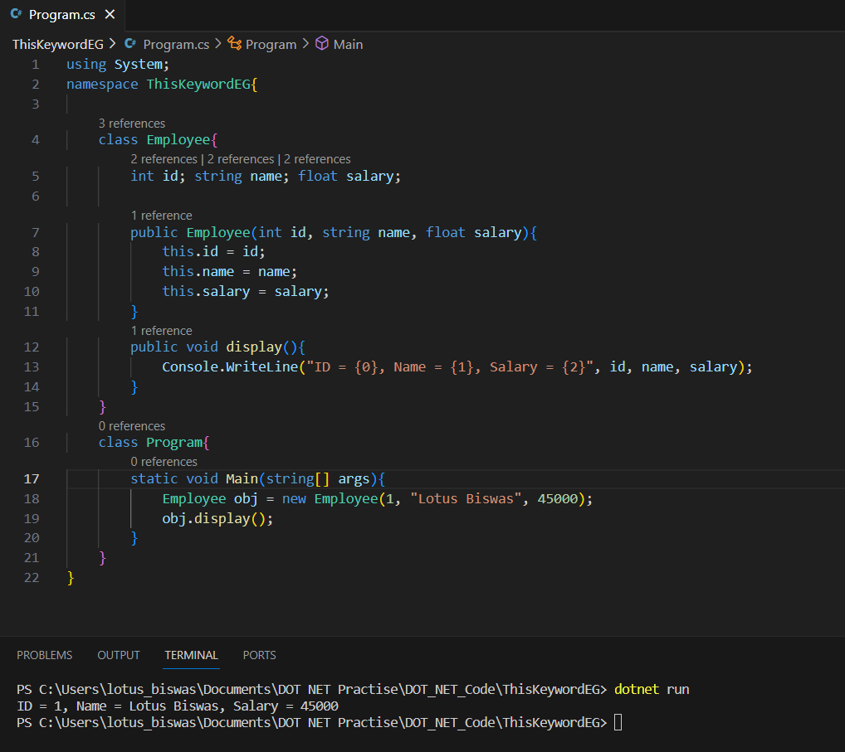
C# this keyword
this is a keyword that refers to the current instance of the class.
Used to refer to the current class instance variable.
Used to refer to the current class method.
Used to pass current object as a parameter to another method
Used to declare indexers

Slide 71
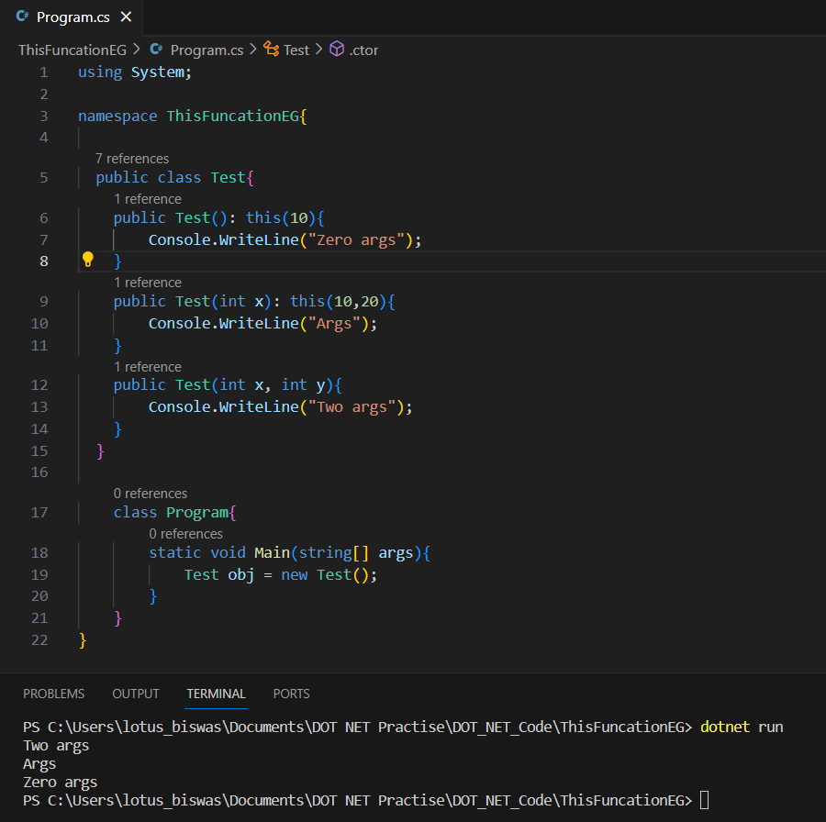
C# this()
This() is same as constructor chaining
Invoking constructor from another constructor is called Chaining.
this() method is used to invoke constructor

Slide 72
This and this() difference
This | This()
This keyword is used with the objects only. | This() is used with constructors only.
It refers to the current object. | It refers to the constructor of the same class whose parameters matches with the parameters passed to this(parameters).
Dot(.) operator is used to access the members. For EG: This.variableName; | No Dot(.) operator is used. Only the matching parameters are passed.
It is used to differentiate between the local variable and the instance variable in the method. | It is used to refer to the constructor belonging to the same class.

Slide 73
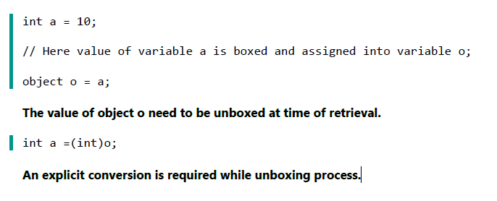
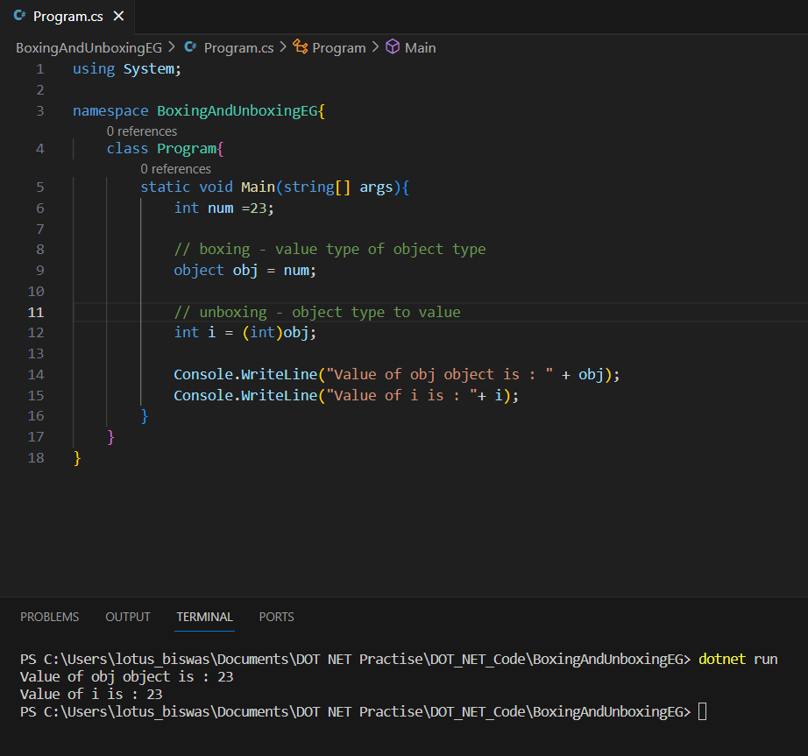
C# boxing and unboxing
There are 2 types in C# one is value type and other is reference type. Object is the base class of all the types in C#.
When a value type is converted into object type then this implicitly conversion process is called boxing. On the other hand, when an object type is converted back to its value type explicitly then it is called as unboxing.
Value Type variables are always stored in Stack memory, while Reference Type variables are stored in Heap memory.
Boxing is typically used when you need to store value types in a collection that requires objects, such as ArrayList or List. Unboxing is used when retrieving the value type from the object.

Slide 74
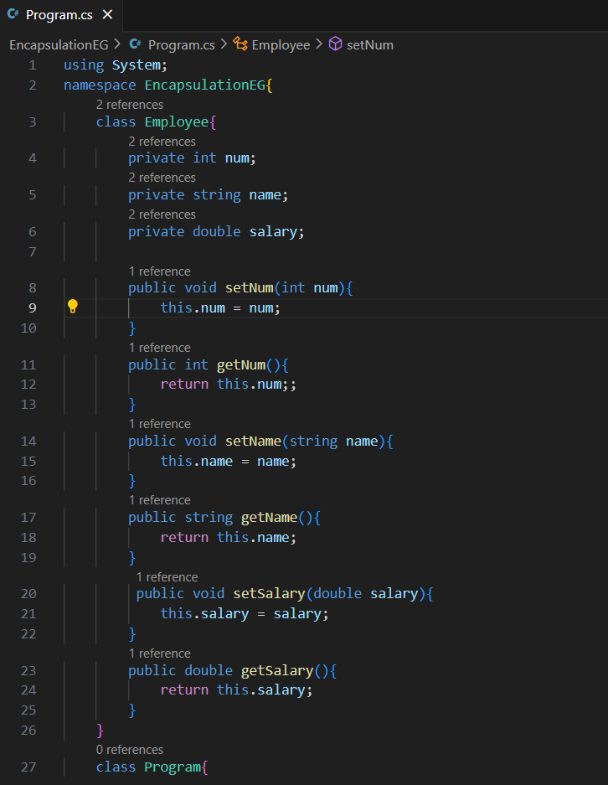
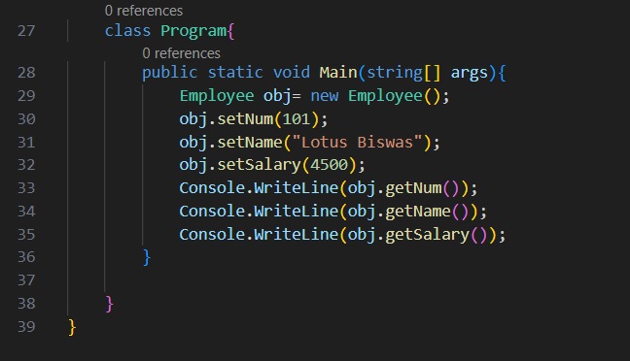
C# Encapsulation
Binding or wrapping up of code, into a single unit.
The concept of protecting the data within the class itself.
We implement Encapsulation through POCO rules. (Plain old CLR Object)
Class is Public (to make the object visible in communication).
Variables are Private (other objects cannot access the data directly).
Methods are public (to send and receive the data).

Slide 75
Purpose of encapsulation
The purpose of encapsulation is to prevent alteration of data from outside. This data can only be accessed by getter functions of the class.
A fully encapsulated class has getter and setter functions that are used to read and write data. This class does not allow data access directly.

Slide 76
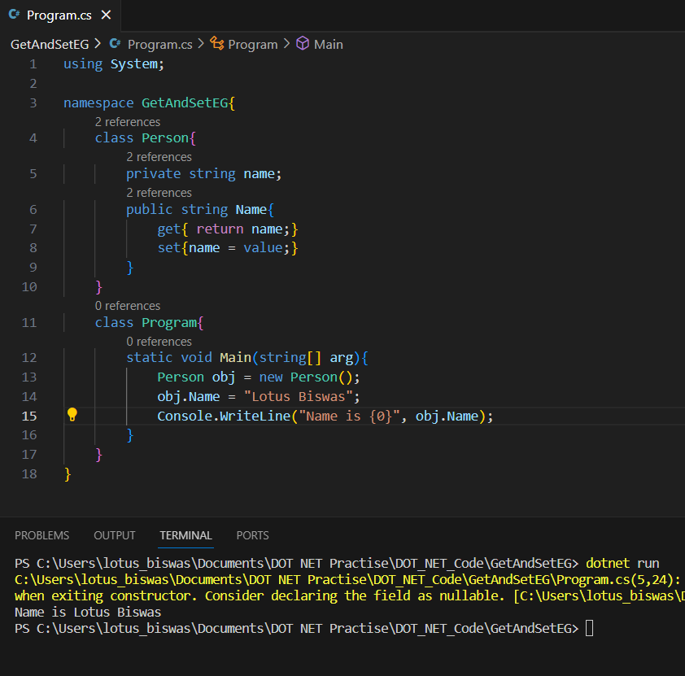
C# Get and Set
Alternative way to achieve encapsulation
The Name property is associated with the name field. It is a good practice to use the same name for both the property and the private field, but with an uppercase first letter.
The get method returns the value of the variable name.
The set method assigns a value to the name variable. The value keyword represents the value we assign to the property.

Slide 77
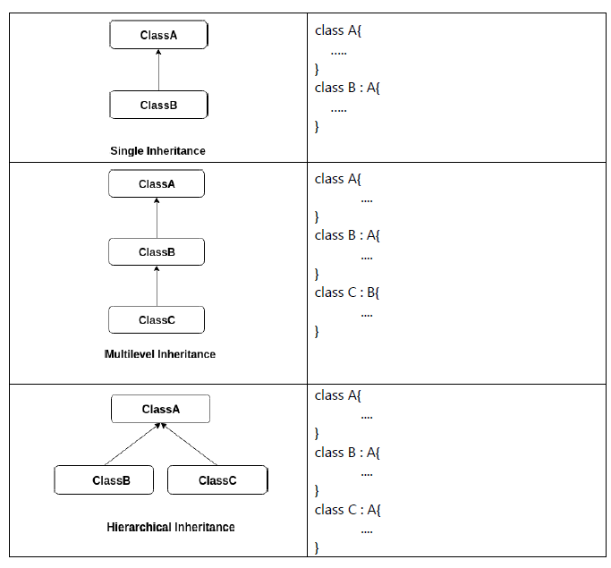
C# Inheritance
When one object acquires all the properties and behaviour of another object it is called inheritance. It provides code reusability.
Terminology:
Parent/Super class: The class from which members are re-used.
Child/Sub class: The class which is using the members
Types of Inheritance:
1. Single Inheritance - supported
2. Multi-Level Inheritance - supported
3. Hierarchical Inheritance - supported
4. Multiple Inheritance - not supported

Slide 78
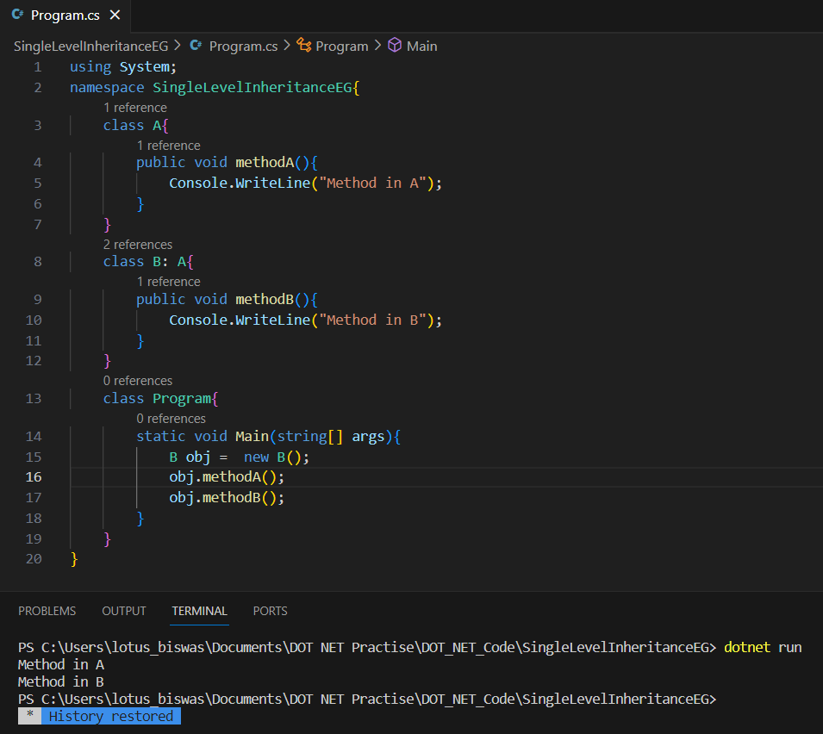
Single Level Inheritance
When one class inherits another class, it is known as single level inheritance.

Slide 79
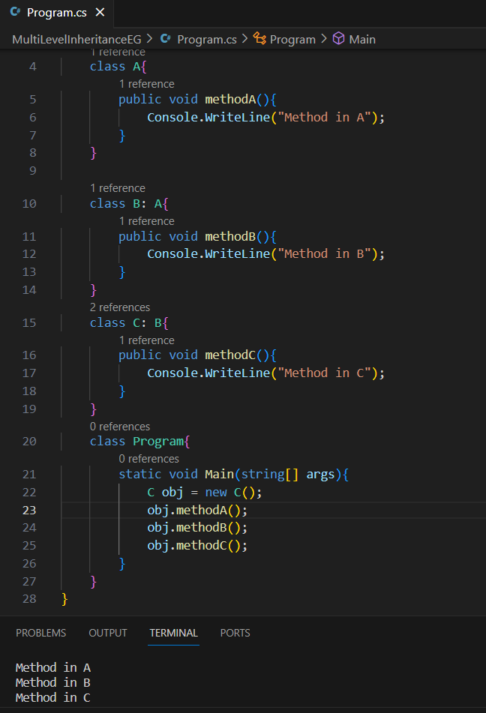
Multi-level Inheritance
When there is a chain of inheritance.
When one class inherits another class which is further inherited by another class, it is known as multi level inheritance in C#.

Slide 80
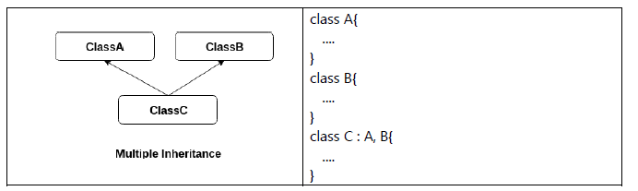
Why C# not supports Multiple inheritance?
C# does not support multiple inheritance through classes to avoid certain complications and ambiguities that can arise with this programming paradigm.
1. Diamond Problem
One of the main issues with multiple inheritance is the "diamond problem." This occurs when a class inherits from two classes that have a common ancestor. If both base classes have a method with the same name, it can create ambiguity when trying to call that method in the derived class.
2. Code Complexity
3. Implementation Challenges

Slide 81
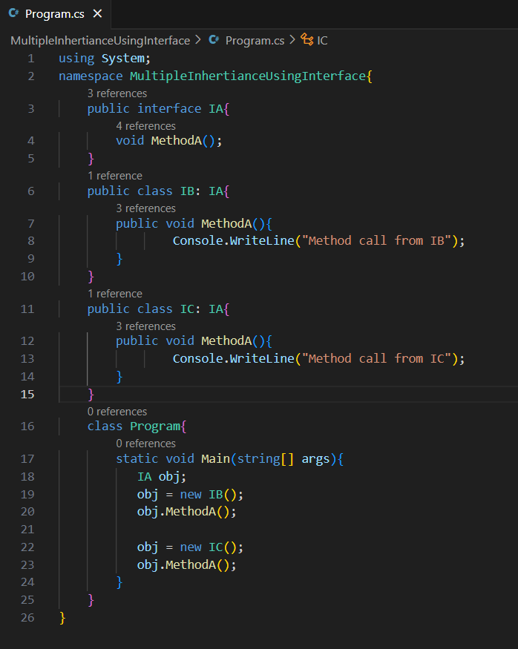
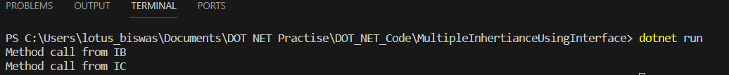
Multiple inheritance implementation
Multiple inheritance can only be achieved using interface.

Slide 82
Polymorphism
Polymorphism is the concept where object behaves differently in different situations.
2 Types:
Compile time polymorphism
Run time polymorphism
Compile Time Polymorphism | Run time Polymorphism
It is method overloading technique. | It is a Method overriding technique
Defining multiple methods with same name and different signature(parameters). | Defining a method in the Child class with the same name and same signature of its Parent class.
Provides fast execution since the method to be executed is known as compile time | Provides slow execution since the method to be executed is known at runtime.
Less flexible since all things execute at compile time. | More flexible since all things execute at runtime.

Slide 83
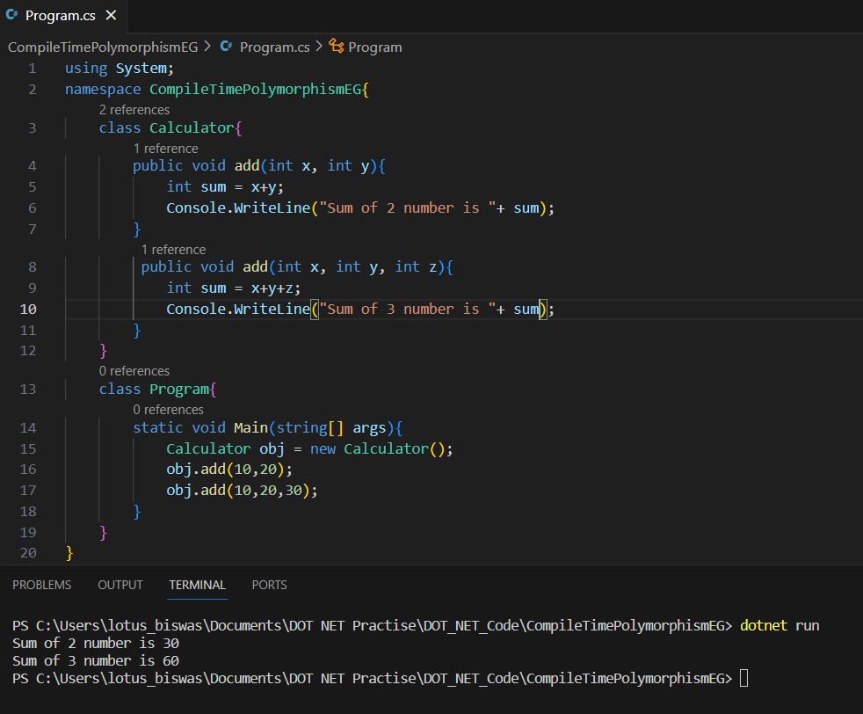
Compile Time Polymorphism
It is method overloading technique.

Slide 84
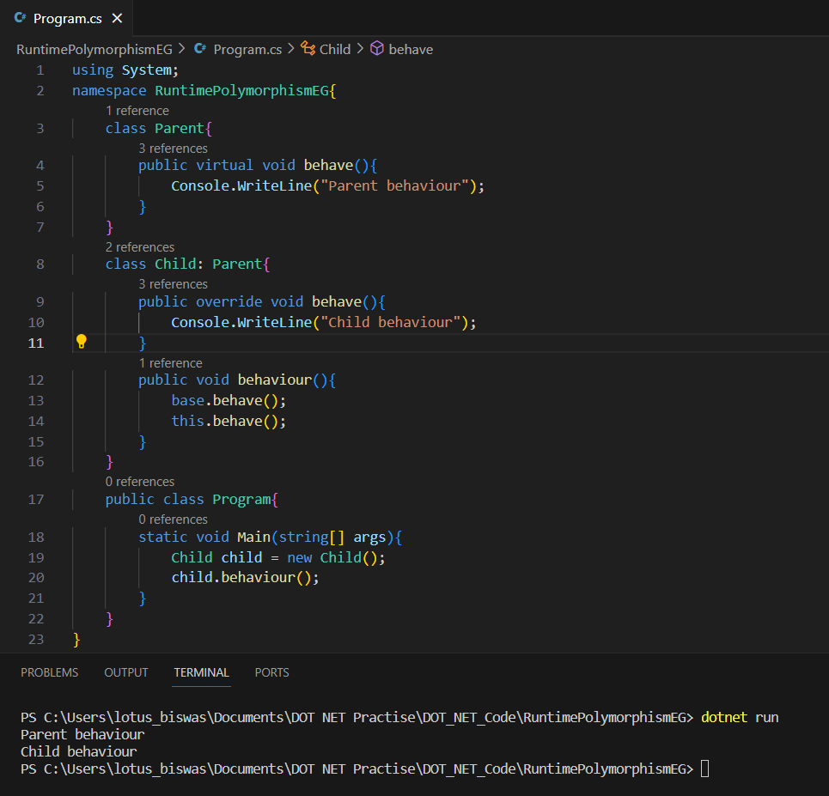
Run time Polymorphism
It is method overriding technique.
We can implement Method overriding only in Parent-Child (Is-A) relation.

Slide 85
C# Abstraction
Hiding internal details and showing only the functionality to the user.
They cannot be instantiated.
Can have constructor and static method also.
The abstract keyword is used for classes and methods:
Abstract class: is a restricted class that cannot be used to create objects (to access it, it must be inherited from another class).
Abstract method: can only be used in an abstract class, and it does not have a body. The body is provided by the derived class (inherited from).

Slide 86
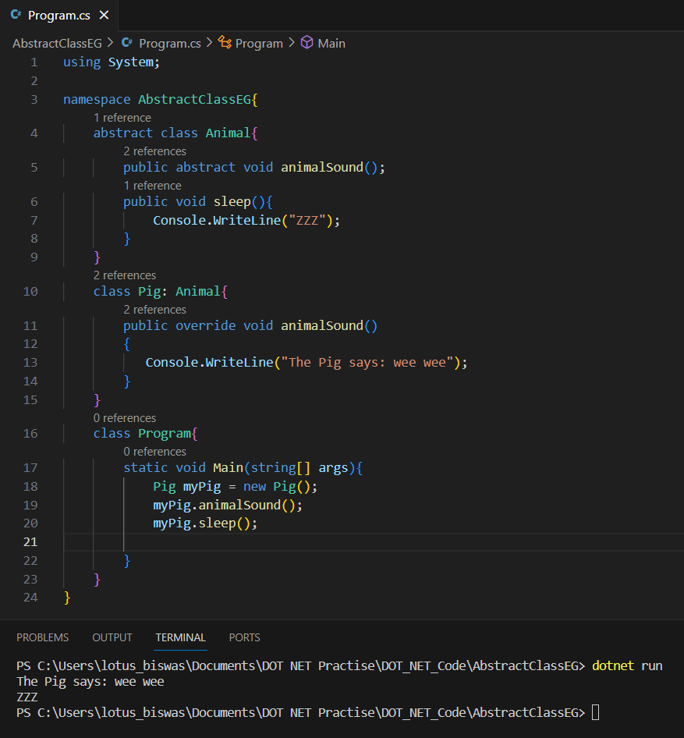
Abstraction Implementation
Abstract Class: Define a class with abstract keyword. Abstract class consists concrete methods and abstract methods.
Concrete Method: A Method with body
Abstract Method: A Method without body

Slide 87
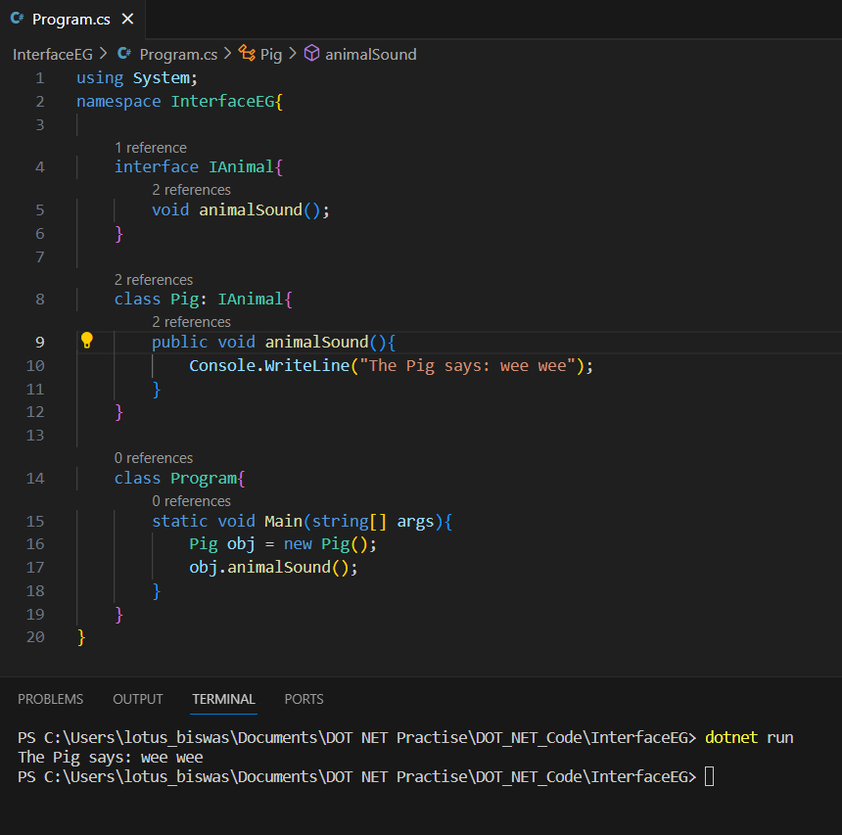
C# Interface
Another way to achieve abstraction in C#, is with interfaces.
An interface is a completely "abstract class", which can only contain abstract methods and properties (with empty bodies)
Why And When To Use Interfaces?
To achieve security
And to implement multiple inheritance
KB
Interfaces can contain properties and methods, but not fields/variables
Interface members are by default abstract and public
An interface cannot contain a constructor (as it cannot be used to create objects)

Slide 88
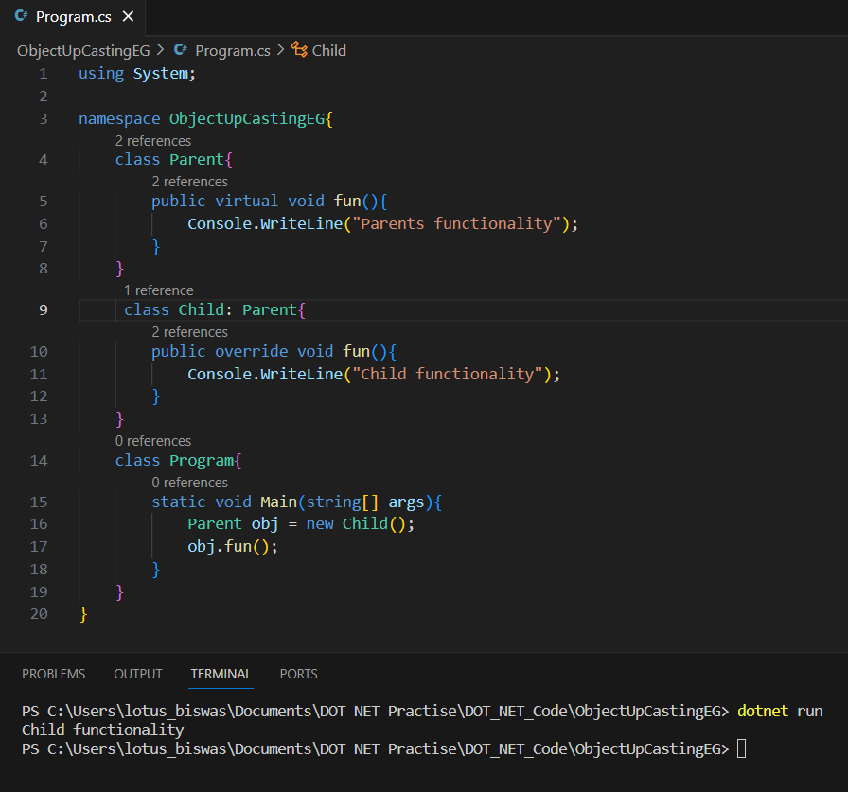
Object-Up Casting
We can store the address of Child class into Parent type reference variable.
Using parent address reference variable, we can access the functionality of Child class.
Public addr = new Child();
or
Child obj = new Child();
Parrent addr = obj;

Slide 89
Object-Down Casting
We can store the address of Parent class into Child type reference variable.
Using child address reference variable, we can access the functionality of Parent class.
Child addr = new Parent();
or
Parent obj = new Parent();
Child addr = obj;

Slide 90
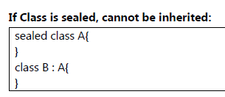
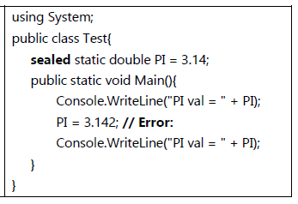
Sealed Keyword
It is a keyword/modifier
A member become constant if we define it is sealed hence cannot be modified.
We can apply sealed modifier to Class or Method or Variable.

